Slide 1
Introduction to DBMS
Database management system is a software which is used to manage the database. For example: MySQL, Oracle, etc. are a very popular commercial database which is used in different applications.
The database is a collection of inter-related data which is used to retrieve, insert and delete the data efficiently. It is also used to organize the data in the form of a table, schema, views, and reports, etc.
It provides protection and security to the database. In the case of multiple users, it also maintains data consistency.

Slide 2
DBMS allows users the following tasks:
Data Definition: It is used for creation, modification, and removal of definition that defines the organization of data in the database.
Data Updation: It is used for the insertion, modification, and deletion of the actual data in the database.
Data Retrieval: It is used to retrieve the data from the database which can be used by applications for various purposes.
User Administration: It is used for registering and monitoring users, maintain data integrity, enforcing data security, dealing with concurrency control, monitoring performance and recovering information corrupted by unexpected failure.

Slide 3
Characteristics of DBMS
It uses a digital repository established on a server to store and manage the information.
It can provide a clear and logical view of the process that manipulates data.
DBMS contains automatic backup and recovery procedures.
It contains ACID properties which maintain data in a healthy state in case of failure.
It can reduce the complex relationship between data.
It is used to support manipulation and processing of data.
It is used to provide security of data.
It can view the database from different viewpoints according to the requirements of the user.

Slide 4
Advantages of DBMS
Controls database redundancy
Data sharing
Easily Maintenance
Reduce time:Backup
Multiple user interface:

Slide 5
Disadvantages of DBMS
Cost of Hardware and Software
Size
Complexity
Higher impact of failure

Slide 6
Data Model
Data Model gives us an idea that how the final system will look like after its complete implementation.
It defines the data elements and the relationships between the data elements.
Data Models are used to show how data is stored, connected, accessed and updated in the database management system.
Various data models can be divided into four categories, such as:
Conceptual Data Models
Record Based Data Models
Object Based Data Models
Physical Data Models

Slide 7
1) Conceptual (or High-Level) Data Models
Conceptual data models use concepts such as entities, attributes, and relationships
An entity is a person, place, thing, event, or concept about which information is recorded.
Attribute gives the characteristic of the entity .
A relationship among two or more entities represents an interaction among the entities; for example, a work on relationship between an employee and a project
2) Record Based Data Models
Record based data models represent data by using the record structures.
These database is structured in a fixed format records of several types. These models lie between the object based data models and the physical data models. i)Hierarchical Data Model (Use Tree Structures )
(ii)Relational Data Model (Use Plex Structures )
(il) Network Data Model (Use Normalize Structures)

Slide 8
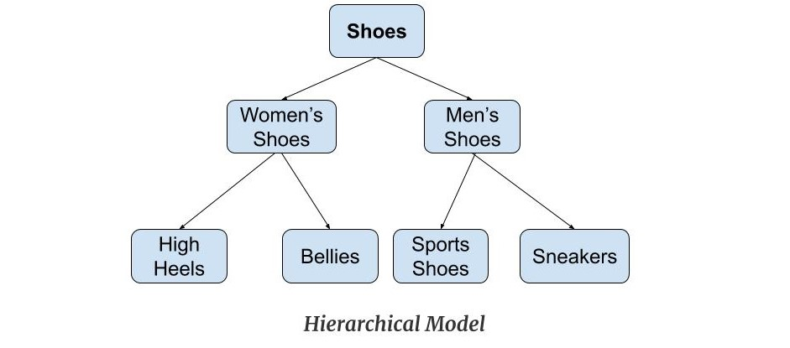
Hierarchical Model
Hierarchical Model was the first DBMS model. This model organizes the data in the hierarchical tree structure. The hierarchy starts from the root which has root data and then it expands in the form of a tree adding child node to the parent node. This model easily represents some of the real-world relationships like food recipes, sitemap of a website etc.
Example: We can represent the relationship between the shoes present on a shopping website in the following way:

Slide 9
Basic Operations on Hierarchical Data Model:
i)Deletion:
If we want to remove the class, say CS01, then student with STUID equals to 100 will also have to be removed. So deletion is very difficult.
ii)Insertion:
A new class, say CS03 can not be introduced unless some faculty is available at root level. So insertion is also difficult
iii)Updation:
Suppose ROOM has changed. For this change, search problem will occur which is time consuming.
Hence, this model has problem in insertion, deletion and updation .

Slide 10
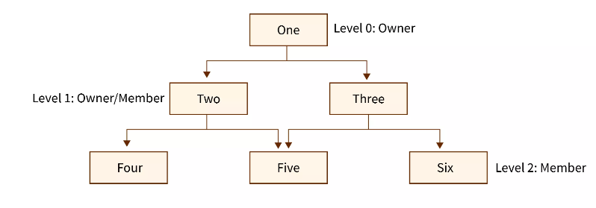
Network Model
The Network Model in DBMS is a hierarchical model that is used to represent the many-to-many relationship among the database constraints. It is represented in the form of a graph hence it is a simple and easy-to-construct database model.

Slide 11
Basic Operations on Network Data Model:
Network model is more symmetric in nature than hierarchical model.
i)Insertion:
New part or supplier can be easily inserted
ii)Deletion:
Deletion operation is very simple, only link is to be removed. No information is lost. For example to remove, PART 2, we delete the connector record occurrence linking the part .
iii)Updation:
Suppose supplier B supplies PART 1 in place PART 2, We can make this change simply changing the link of SUPPLIER B from PART 2 to PART 1.
Hence, updation is also very easy in this model.

Slide 12
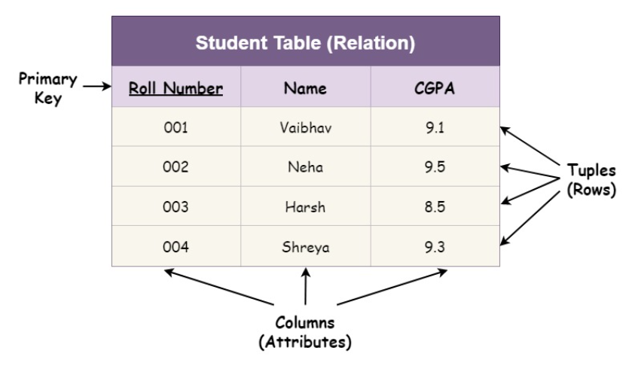
Relational Model
The relational model in DBMS is an abstract model used to organize and manage the data stored in a database. It stores data in two-dimensional inter-related tables, also known as relations in which each row represents an entity and each column represents the properties of the entity.

Slide 13
Basic Operations on Relational Data Model:
i)Insertion:
A new student, in figure 3.9, can be inserted quite easily. So in the relational model, insertion is quite easy.
ii)Deletion:
Deletion is also easy. For example, delete a tuple from STUDENT relation in figure 3.9 whose STUID is 1001.
iii)Updation:
Updation is also easy. For example change the Subject of student whose STUID is 1005 from History to Hindi .
Hence in relation model, insertion, deletion and updation operation are quite easy.

Slide 14
Object Based Data Models
A Object-Oriented Data Model is a logic organisation of the real world objects, constraints on them and the relationships among objects. A object-oriented data model consists of :
Static properties such as objects, attributes and relationships.
Integrity rules over objects and operations; and
Dynamic properties such as operations or rules defining new database states based on applied state changes .
Physical Data Models
Physical data model describes the data in terms of a collection of files, indices, and other storage structures such as record formats, record ordering, and access paths .
This model specifies how the database will be executed in a particular DBMS software such as Oracle, Sybase, etc., by taking into account the facilities and constraints of a given database management system.
It also describes how the data is stored on disk and what access methods are available to it.

Slide 15
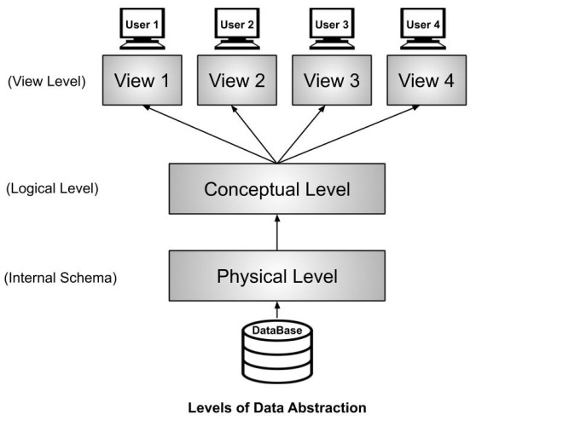
Levels of abstraction for DBMS
Database systems include complex data-structures. In terms of retrieval of data, reduce complexity in terms of usability of users and in order to make the system efficient, developers use levels of abstraction that hide irrelevant details from the users. Levels of abstraction simplify database design.
Mainly there are three levels of abstraction for DBMS, which are as follows −
Physical or Internal Level
Logical or Conceptual Level
View or External Level

Slide 16
Physical or Internal Level
It is the lowest level of abstraction for DBMS which defines how the data is actually stored, it defines data-structures to store data and access methods used by the database.
It is a very complex level to understand.
For example, customer's information is stored in tables and data is stored in the form of blocks of storage such as bytes, gigabytes etc.
Logical or Conceptual Level
Logical level is the intermediate level or next higher level.
It describes what data is stored in the database and what relationship exists among those data.
It tries to describe the entire or whole data because it describes what tables to be created and what are the links among those tables that are created.

Slide 17
View or External Level
It is the highest level. In view level, there are different levels of views and every view only defines a part of the entire data.
It also simplifies interaction with the user and it provides many views or multiple views of the same database.
View level can be used by all users (all levels' users).
This level is the least complex and easy to understand.
For example, a user can interact with a system using GUI that is view level and can enter details at GUI or screen and the user does not know how data is stored and what data is stored, this detail is hidden from the user.

Slide 18
Database Users
These are seven types of data base users in DBMS.
1) Database Administrator (DBA):
Database Administrator (DBA) is a person/team who defines the schema and also controls the 3 levels of database.
The DBA will then create a new account id and password for the user if he/she need to access the data base.
DBA is also responsible for providing security to the data base and he allows only the authorized users to access/modify the data base.
• DBA also monitors the recovery and back up and provide technical support.
• The DBA has a DBA account in the DBMS which called a system or superuser account.
• DBA repairs damage caused due to hardware and/or software failure.
Database Users
2)Naive / Parametric End Users : Parametric End Users are the unsophisticated who don’t have any DBMS knowledge but they frequently use the data base applications in their daily life to get the desired results . For examples, Railway’s ticket booking users are naive users. Clerks in any bank is a naive user because they don’t have any DBMS knowledge but they still use the database and perform their given task.

Slide 19
3)System Analyst : System Analyst is a user who analyzes the requirements of parametric end users. They check whether all the requirements of end users are satisfied.
4)Sophisticated Users : Sophisticated users can be engineers, scientists, business analyst, who are familiar with the database. They can develop their own data base applications according to their requirement. They don’t write the program code but they interact the data base by writing SQL queries directly through the query processor.
5)Data Base Designers : Data Base Designers are the users who design the structure of data base which includes tables, indexes, views, constraints, triggers, stored procedures. He/she controls what data must be stored and how the data items to be related.
6)Application Program : Application Program are the back end programmers who writes the code for the application programs.They are the computer professionals. These programs could be written in Programming languages such as Visual Basic, Developer, C, FORTRAN, COBOL etc.
7)Casual Users / Temporary Users : Casual Users are the users who occasionally use/access the data base but each time when they access the data base they require the new information, for example, Middle or higher level manager.

Slide 20
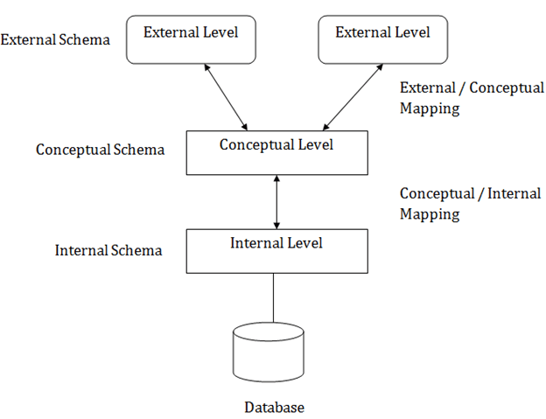
Three schema Architecture
The three schema architecture is also called ANSI/SPARC architecture or three-level architecture.
This framework is used to describe the structure of a specific database system.
The three schema architecture is also used to separate the user applications and physical database.
The three schema architecture contains three-levels. It breaks the database down into three different categories.

Slide 21
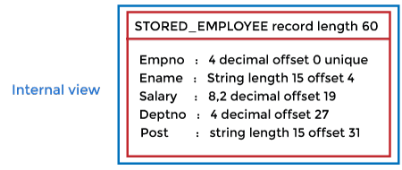
It shows the DBMS architecture.
Mapping is used to transform the request and response between various database levels of architecture.
Mapping is not good for small DBMS because it takes more time.
In External / Conceptual mapping, it is necessary to transform the request from external level to conceptual schema.
In Conceptual / Internal mapping, DBMS transform the request from the conceptual to internal level.
The main objective of three level architecture is to enable multiple users to access the same data with a personalized view while storing the underlying data only once. Thus it separates the user's view from the physical structure of the database
1. Internal Level:
The internal level has an internal schema which describes the physical storage structure of the database.
The internal schema is also known as a physical schema.
It uses the physical data model. It is used to define that how the data will be stored in a block.
The physical level is used to describe complex low-level data structures in detail.

Slide 22
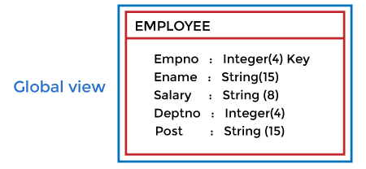
2. Conceptual Level
The conceptual schema describes the design of a database at the conceptual level. Conceptual level is also known as logical level.
The conceptual schema describes the structure of the whole database.
The conceptual level describes what data are to be stored in the database and also describes what relationship exists among those data.
In the conceptual level, internal details such as an implementation of the data structure are hidden.
Programmers and database administrators work at this level.
3. External Level
At the external level, a database contains several schemas that sometimes called as subschema. The subschema is used to describe the different view of the database.
An external schema is also known as view schema.
Each view schema describes the database part that a particular user group is interested and hides the remaining database from that user group.
The view schema describes the end user interaction with database systems.

Slide 23
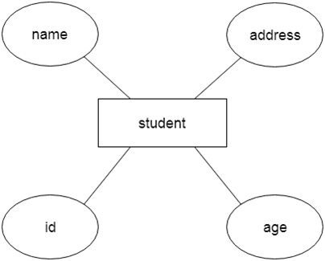
ER Model
ER model stands for an Entity-Relationship model. It is a high-level data model. This model is used to define the data elements and relationship for a specified system.
It develops a conceptual design for the database. It also develops a very simple and easy to design view of data.
In ER modeling, the database structure is portrayed as a diagram called an entity-relationship diagram.
For example, Suppose we design a school database. In this database, the student will be an entity with attributes like address, name, id, age, etc. The address can be another entity with attributes like city, street name, pin code, etc. and there will be a relationship between them.

Slide 24
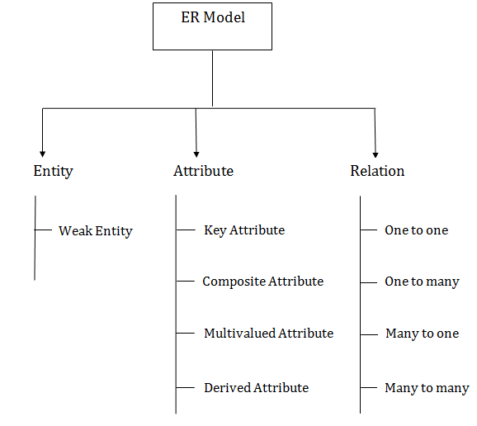
Component of ER Diagram
1. Entity:
An entity may be any object, class, person or place. In the ER diagram, an entity can be represented as rectangles.
Consider an organization as an example- manager, product, employee, department etc. can be taken as an entity.

Slide 25
An entity that depends on another entity called a weak entity. The weak entity doesn't contain any key attribute of its own. The weak entity is represented by a double rectangle.
Entity Set:
An entity set in DBMS is a set that collectively represents a group of entities of a similar type.
For Example: An entity set of cars, an entity set of bank accounts, etc. In DBMS, the whole table in the tabular representation of data is an entity set, while each row inside this table is an entity.
Weak Entity Set-
A weak entity set is an entity set that does not contain sufficient attributes to uniquely identify its entities.
In other words, a primary key does not exist for a weak entity set.
However, it contains a partial key called as a discriminator.
Discriminator can identify a group of entities from the entity set.

Slide 26
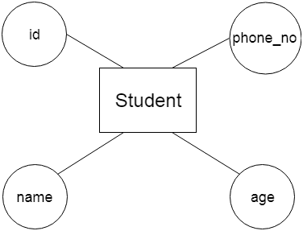
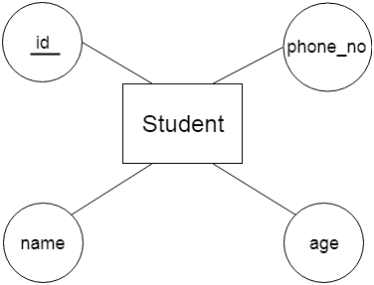
2. Attribute
The attribute is used to describe the property of an entity. Eclipse is used to represent an attribute.
For example, id, age, contact number, name, etc. can be attributes of a student.
a. Key Attribute
The key attribute is used to represent the main characteristics of an entity. It represents a primary key. The key attribute is represented by an ellipse with the text underlined.

Slide 27
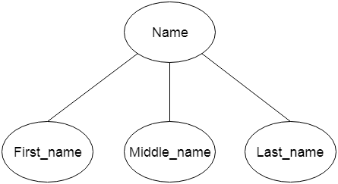
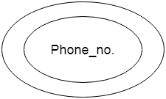
b. Composite Attribute
An attribute that composed of many other attributes is known as a composite attribute. The composite attribute is represented by an ellipse, and those ellipses are connected with an ellipse.
c. Multivalued Attribute
An attribute can have more than one value. These attributes are known as a multivalued attribute. The double oval is used to represent multivalued attribute.
For example, a student can have more than one phone number.

Slide 28
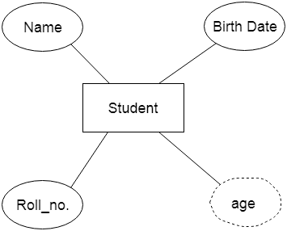
d. Derived Attribute
An attribute that can be derived from other attribute is known as a derived attribute. It can be represented by a dashed ellipse.
For example, A person's age changes over time and can be derived from another attribute like Date of birth.
3. Relationship
A relationship is used to describe the relation between entities. Diamond or rhombus is used to represent the relationship.

Slide 29
Types of relationship are as follows:
One-to-One Relationship:
When only one instance of an entity is associated with the relationship, then it is known as one to one relationship.
For example, A female can marry to one male, and a male can marry to one female.
b. One-to-many relationship:
When only one instance of the entity on the left, and more than one instance of an entity on the right associates with the relationship then this is known as a one-to-many relationship.
For example, Scientist can invent many inventions, but the invention is done by the only specific scientist.

Slide 30
c. Many-to-one relationship:
When more than one instance of the entity on the left, and only one instance of an entity on the right associates with the relationship then it is known as a many-to-one relationship.
For example, Student enrolls for only one course, but a course can have many students.
d. Many-to-many relationship:
When more than one instance of the entity on the left, and more than one instance of an entity on the right associates with the relationship then it is known as a many-to-many relationship.
For example, Employee can assign by many projects and project can have many employees.

Slide 31
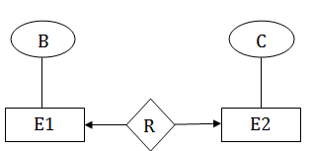
Mapping Constraints
A mapping constraint is a data constraint that expresses the number of entities to which another entity can be related via a relationship set.
It is most useful in describing the relationship sets that involve more than two entity sets.
For binary relationship set R on an entity set A and B, there are four possible mapping cardinalities. These are as follows:
One to one (1:1)
One to many (1:M)
Many to one (M:1)
Many to many (M:M)
One-to-one
In one-to-one mapping, an entity in E1 is associated with at most one entity in E2, and an entity in E2 is associated with at most one entity in E1.

Slide 32
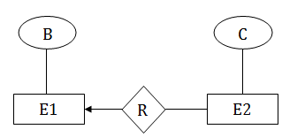
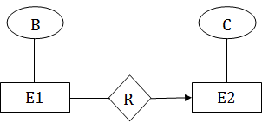
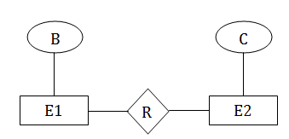
One-to-many
In one-to-many mapping, an entity in E1 is associated with any number of entities in E2, and an entity in E2 is associated with at most one entity in E1.
Many-to-one
In one-to-many mapping, an entity in E1 is associated with at most one entity in E2, and an entity in E2 is associated with any number of entities in E1.
Many-to-many
In many-to-many mapping, an entity in E1 is associated with any number of entities in E2, and an entity in E2 is associated with any number of entities in E1.

Slide 33
Keys
Keys play an important role in the relational database.
It is used to uniquely identify any record or row of data from the table. It is also used to establish and identify relationships between tables.
For example, ID is used as a key in the Student table because it is unique for each student. In the PERSON table, passport_number , license_number , SSN are keys since they are unique for each person.
Types of keys:

Slide 34
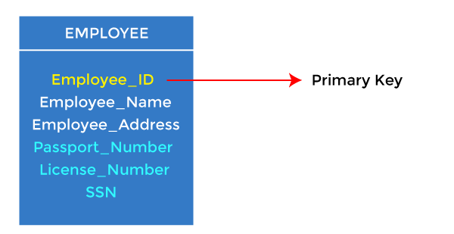
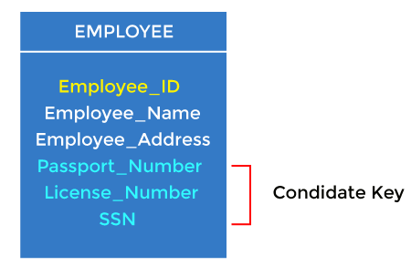
1. Primary key
It is the first key used to identify one and only one instance of an entity uniquely. An entity can contain multiple keys, as we saw in the PERSON table. The key which is most suitable from those lists becomes a primary key.
In the EMPLOYEE table, ID can be the primary key since it is unique for each employee. In the EMPLOYEE table, we can even select License_Number and Passport_Number as primary keys since they are also unique.
For each entity, the primary key selection is based on requirements and developers.
2. Candidate key
A candidate key is an attribute or set of attributes that can uniquely identify a tuple.
Except for the primary key, the remaining attributes are considered a candidate key. The candidate keys are as strong as the primary key.
For example: In the EMPLOYEE table, id is best suited for the primary key. The rest of the attributes, like SSN, Passport_Number, License_Number, etc., are considered a candidate key.

Slide 35
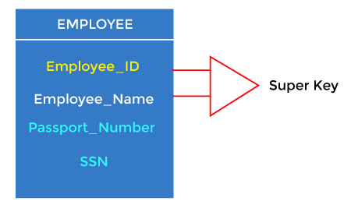
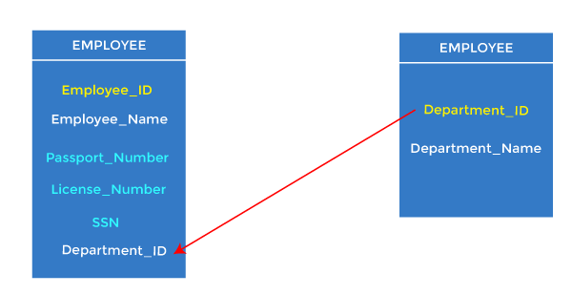
3. Super Key
Super key is an attribute set that can uniquely identify a tuple. A super key is a superset of a candidate key. For example: In the above EMPLOYEE table, for(EMPLOEE_ID, EMPLOYEE_NAME), the name of two employees can be the same, but their EMPLYEE_ID can't be the same. Hence, this combination can also be a key.
4. Foreign key
Foreign keys are the column of the table used to point to the primary key of another table.
Every employee works in a specific department in a company, and employee and department are two different entities. So we can't store the department's information in the employee table. That's why we link these two tables through the primary key of one table.
We add the primary key of the DEPARTMENT table, Department_Id, as a new attribute in the EMPLOYEE table.
In the EMPLOYEE table, Department_Id is the foreign key, and both the tables are related.

Slide 36
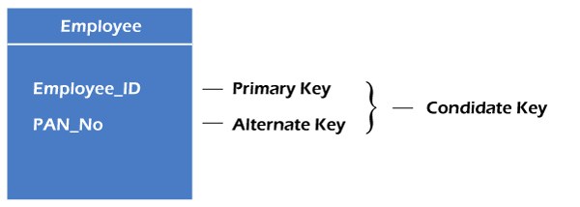
5. Alternate key
There may be one or more attributes or a combination of attributes that uniquely identify each tuple in a relation. These attributes or combinations of the attributes are called the candidate keys. One key is chosen as the primary key from these candidate keys, and the remaining candidate key, if it exists, is termed the alternate key. In other words, the total number of the alternate keys is the total number of candidate keys minus the primary key. The alternate key may or may not exist. If there is only one candidate key in a relation, it does not have an alternate key.
For example, employee relation has two attributes, Employee_Id and PAN_No, that act as candidate keys. In this relation, Employee_Id is chosen as the primary key, so the other candidate key, PAN_No, acts as the Alternate key.

Slide 37
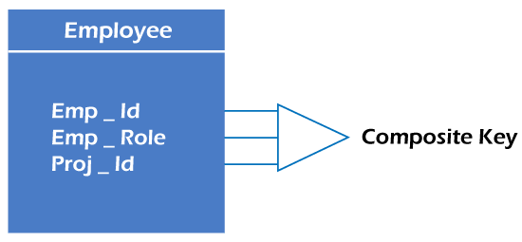
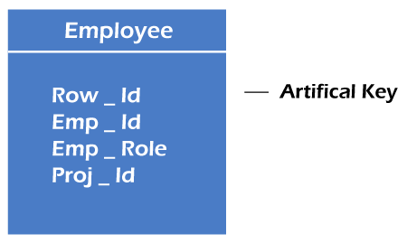
6. Composite key
Whenever a primary key consists of more than one attribute, it is known as a composite key. This key is also known as Concatenated Key. For example, in employee relations, we assume that an employee may be assigned multiple roles, and an employee may work on multiple projects simultaneously. So the primary key will be composed of all three attributes, namely Emp_ID, Emp_role, and Proj_ID in combination. So these attributes act as a composite key since the primary key comprises more than one attribute.
7. Artificial key
The key created using arbitrarily assigned data are known as artificial keys. These keys are created when a primary key is large and complex and has no relationship with many other relations. The data values of the artificial keys are usually numbered in a serial order.
For example, the primary key, which is composed of Emp_ID, Emp_role, and Proj_ID, is large in employee relations. So it would be better to add a new virtual attribute to identify each tuple in the relation uniquely.

Slide 38
Extended E-R Features
Extended ER is a high-level data model that incorporates the extensions to the original ER model. Enhanced ER models are high level models that represent the requirements and complexities of complex databases.
The extended Entity Relationship (ER) models are three types as given below −
Aggregation
Specialization
Generalization
1)Specialization:
The process of designing sub groupings within an entity set is called specialization. It is a top-down process. If an entity set is given with all the attributes in which the instances of the entity set are differentiated according to the given attribute value, then that sub-classes or the sub-entity sets can be formed from the given attribute.
Example
Specialization of a person allows us to distinguish a person according to whether they are employees or customers. Specialization of account creates two entity sets: savings account and current account.

Slide 39
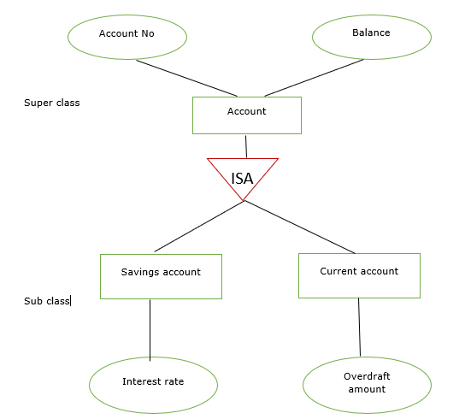
In the E-R diagram specialization is represented by triangle components labeled ISA. The ISA relationship is referred as superclass- subclass relationship as shown below −

Slide 40
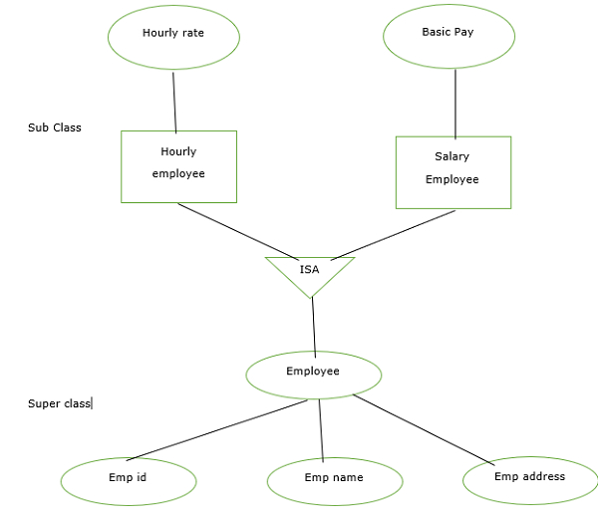
2)Generalization:
It is the reverse process of specialization. It is a bottom-up approach.
It converts subclasses to superclasses . This process combines a number of entity sets that share the same features into higher-level entity sets.
If the sub-class information is given for the given entity set then, ISA relationship type will be used to represent the connectivity between the subclass and superclass as shown

Slide 41
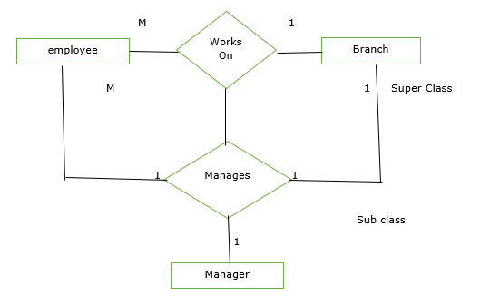
3)Aggregation:
It is an abstraction in which relationship sets are treated as higher level entity sets and can participate in relationships. Aggregation allows us to indicate that a relationship set participates in another relationship set.
Aggregation is used to simplify the details of a given database where ternary relationships will be changed into binary relationships. Ternary relation is only one type of relationship which is working between three entities.

